Slide 1

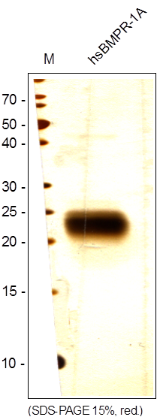
ReliaTech GmbH
Recombinant human BMPR-1 alpha
(Cat# S01-021)
Figure 1: SDS-PAGE analysis of recombinant human BMPR-1 alpha produced in insect cells. Sample was loaded under reducing conditions in 15% SDS-polyacrylamide gel and stained with Silver stain.
http://www.reliatech.de / orders@reliatech.de

